Slide 1
Playerunkown’s battlegrounds capstone project
By Michael Lee

Slide 2
What is playerunknown’s battlegrounds?
PlayerUnknown’s Battlegrounds, also known as PUBG, is part of a subgenre of shooting games known as Battle Royale.
100 players are loaded into a map from the sky and each player parachutes to a point on the map that they choose. Players then gather weapons and other items all in an attempt to be the last survivor on the map.
In order to keep the game moving at a steady pace, safe zones are made on the map that get smaller as time goes on, and players outside of the safe zone suffer damage unless they enter the safe zone.

Slide 3
The model
To predict the time that a player will die in a match
The model will only use data from matches in the map Erangel and only party sizes of 1 so team factors like resurrecting fallen teammates is eliminated
Could not load both datasets due to physical memory limitations so was only able to use one dataset to create the model

Slide 4
Safe zone timers
Circle | Time until blue circle starts to shrink | White circle diameter | Damage per second (without distance variation) | Time until blue meets white
1 | 300 seconds (5 minutes) | 4550 m | 0.4% | 300 seconds (5 minutes)
2 | 200 seconds (3 minutes 20 seconds) | 2970 m | 0.6% | 140 seconds (2 minutes 20 seconds)
3 | 150 seconds (2 minutes 20 seconds) | 1480 m | 0.8% | 90 seconds (1 minute 30 seconds)
4 | 120 seconds | 740 m | 1% | 60 seconds
5 | 120 seconds | 360 m | 3% | 40 seconds
6 | 90 seconds | 175 m | 5% | 30 seconds
7 | 90 seconds | 90 m | 7% | 30 seconds
8 | 60 seconds | 40 m | 9% | 30 seconds
The first circle starts closing in at 5 minutes into the match then fully closes at 10 minutes

Slide 5
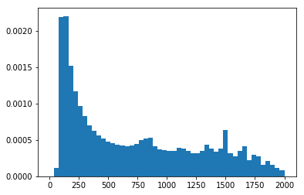
Histogram of total deaths
The highest probability of death is in the first 250 seconds of a match
Indicates that the highest amount of action takes place in the first few minutes of a match
The probability of death levels off with peaks every few minutes starting at around 750 seconds

Slide 6
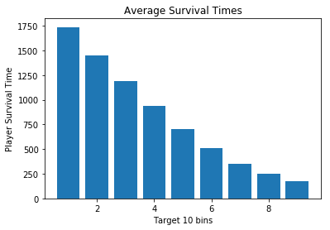
Average survival times for every tenth placement
The average survival time for players that place between 80th and 100th place are very close to each other and also is only 4 minutes into a match which indicates a large amount of fighting soon after landing on the ground.
Afterwards the average survival times increase steadily from 70th to top 10

Slide 7
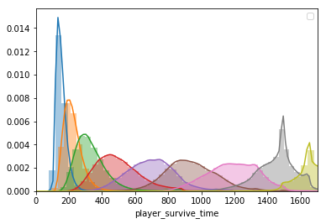
This Histogram shows the death timer distribution for every 10 players in a match. The first 3 distributions overlap each other greatly and have peaks very close to one another. This is understandable since The first few minutes of a match typically has the highest number of deaths compared to any other point in the game. The other distributions are more spread out and look more normal until the last 2 distributions, that look very irregular, most likely due to changing player behaviors, from safe zone chasing, to trying to hunt other players and survive.

Slide 8
Model features for death time prediction
Number of Player Kills – Number of kills that a player got in a match
Placement - from 1 to max number of players in the match, with 1 being the winner
Player Damage – Amount of damage inflicted onto other players
Number of meters driven
Number of meters walked
Number of knockdowns
Number of assists

Slide 9
What did the model show?
Predicted survival time with a Mean Absolute Error of 78.9 seconds.
As number of kills go up, the survival time increases
As distance walked and driven in a match increases so does the predicted survival time

Slide 10
possible improvements for the model
Find more data about weapons and its effect on survival times
Split up death data by safe zones to see player behavior changes for each successive safe zone
Check for changes in the game and its effects as big updates are introduced to the game
Finding data about players’ ranking and its relationship to survival times

Slide 11
Possible changes for pubg
Reduce map size to increase player interactions once safe zones start
Increase item drops in other areas to reduce early game fighting
Have safe zones in already popular areas so the action never slows down completely, as other players join the fight

Slide 12
Sources
https://www.kaggle.com/skihikingkevin/pubg-match-deaths/home
https://pubg.gamepedia.com/The_Playzone

